Slide 1

Tableau Is A Powerful And Fastest Growing Data Visualization Tool Used In Business Intelligence Industry
It is extensively used by organizations to make sense of data in a visually insightful format.
Tableau can work with any kind of data be it structured, unstructured or semi-structured.

Slide 2
Tableau Product Family
Tableau Desktop
Tableau Desktop allows the user to connect the data from different sources and build, dashboards, stories, and workbooks, With the Tableau Desktop and website, you can share all the insights with other users and publish the workbooks on the Tableau site.
Tableau Server
Tableau Server is used for publishing the reports and workbooks created on the Tableau Desktop. It enables the user to access workbooks and reports from anywhere in the world.
Tableau Reader
It’s a free application that you can install on your desktop and use to view the data visualizations built by the users on Tableau Desktop. On Tableau Reader, you can view, interact, add different types of filters, and drill down the data without altering the original datasets and visualizations.

Slide 3
Tableau Public
This Tableau Public tutorial also demonstrates how it’s free software that anyone can use to analyze the data and create visualizations. You can create workbooks or reports and save them in the Tableau Server, but anyone can see those visualizations as its open for everyone.
Tableau Online
Tableau Online is a cloud platform that makes it easy to publish and share the dashboards with other users. It helps you and your colleagues to work on a project and extract valuable information that can convert them into visually interactive workbooks. These visuals can be accessed by the website, Tableau Desktop, and Tableau mobile applications.

Slide 4
Tableau Workspace
It includes toolbar, menus, Data window, cards that hold shelves and legends and sheets. Sheets can be dashboards or worksheets.
Worksheets hold shelves which are where you drag data fields to build views. You can alter the default layout of the shelves and cards to suit your requirements including resizing, moving and hiding them.
Dashboards hold views, legends and quick filters. When you first make a dashboard the Dashboard is empty and all of the worksheets in the workbook are displayed in the Dashboard window.

Slide 5
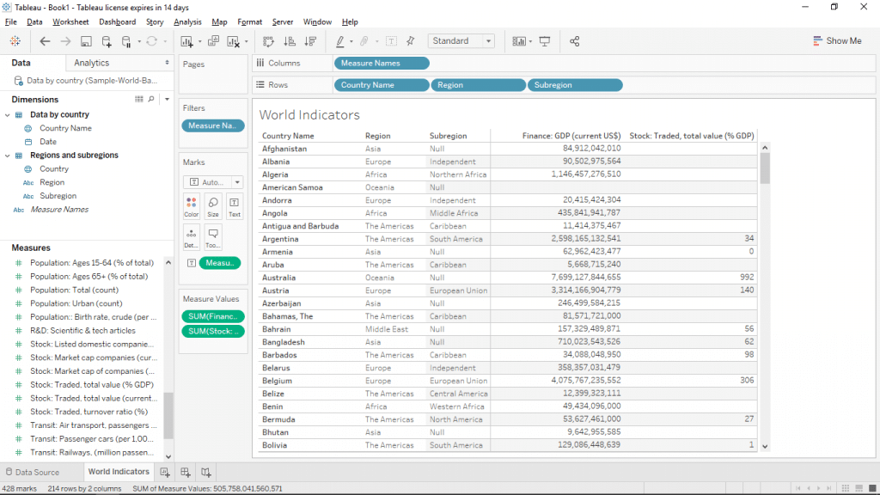
Cards and shelves
Workbook name
Tool bar
Data view
view
Status bar

Slide 6
Data Window
Data field appears on the left side of the workspace in the data window.
You can hide and show the Data window by selecting window > Show Data Window.
You can also click the minimize button in the upper right corner of the Data window.
Toolbar
Tableau’s Toolbar contains a command like connect to data, New sheet and Save.
It also contains analysis and navigation tools like Sort, Group and Highlight.
Status Bar
It is located on the bottom of the Tableau workbook.
It displays descriptions of menu items as well as information about the current view.
Cards and Shelves
Every worksheet contains a variety of different cards that you can show or hide.
Cards are containers for shelves, legends and other controls.
It can be shown and hidden as well as rearranged around the worksheet.

Slide 7
Tableau Data Source Connection
Basic Connection
To examine your tableau data, firstly you have to connect Tableau to one or more data sources. A Tableau data source can be as easy as an Excel workbook, or as elaborate as a SQL Server or Oracle data warehouse. After connecting, the data fields become presented in the Data window on the left side of the workbook.

Slide 8
Introduction to Tableau Joins
A way to extract data from multiple tables in the database is by Tableau Joins. They enable us to get data from different tables provided that the tables have certain fields common. The common field shall be the primary key in one table that acts as a foreign key in another. Various types of Joins include Inner Join, Left Join, Right Join, and Full Outer Join. Tableau allows us to perform joins in a very easy manner. It offers a guided approach to join the two tables providing a couple of important options. Using the functionality we can get data from different tables for analysis.

Slide 9
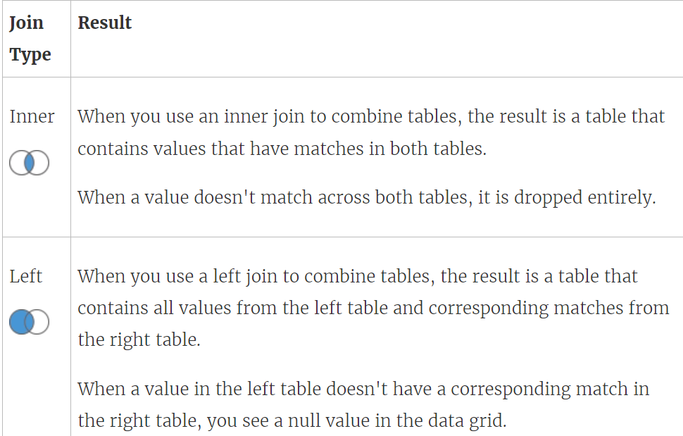

Slide 10
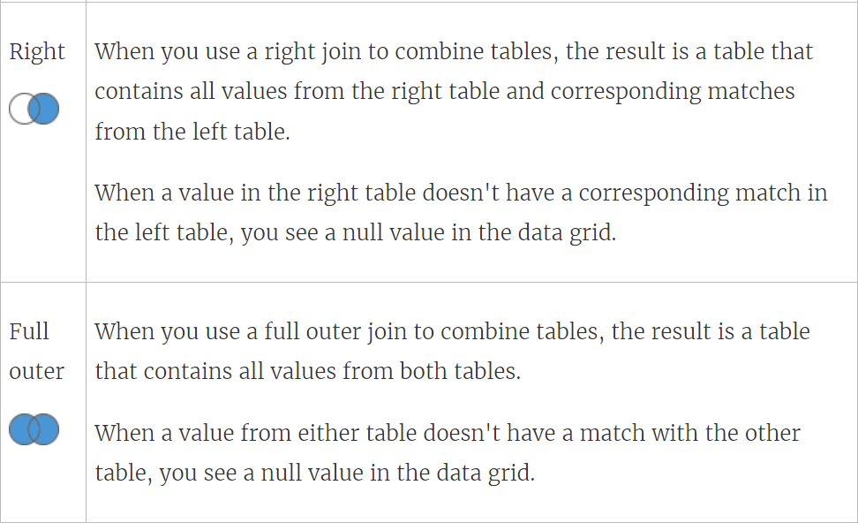

Slide 11
Live And Extract Connections
Live and Extract are the data connections that one uses for data analytics and visualization in Tableau.
Extract connections are the snapshots of data organized for segregation or clustering. These snapshots load directly into Tableau’s memory for faster query processing for data visualization.
Whereas live connections are the connections to the data source that are directly linked to a database and relies on it for all the query processing and also undergoes real-time updates too.
In comparison, life connections are slower than extract connections.

Slide 12
Tableau -- Field Types
When you connect to a new data source, tableau assigns each field in the data source to either the dimensions area or the measure area of the data pane, depending on the type of data the field contains
If a field contains categorical data (such as name, dates, or geographical data),tableau assigns it to the dimensions area
If the field contains numbers ,tableau assigns it to the measures section

Slide 13
Sorting in tableau
Data can be sorted ascending or descending order by one of these options-
  Data source order-the order that the data source naturally orders the data. Generally for relational data source, this tends to be in alphabetical order
  Alphabetical order- the order of the letters in the alphabet
  Field order- order the data based on the associated values of another field

Slide 14
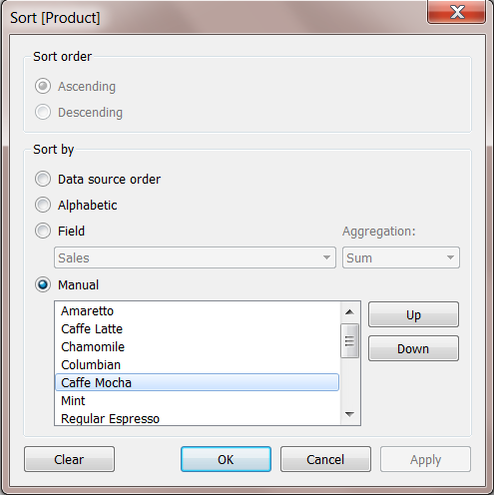
Types of sorting
Computed sorting is the sort directly applied on an axis using the sort dialog button
Manual sorting is used to rearrange the order of dimension fields by arranging them next to each other in an manner

Slide 15
Types of Tableau Filters
Tableau filters can be used to organize and visualize data based on predefined criteria in several ways. Tableau has a total of six different types of filters:
Extract Filter
Data Source Filter
Context Filter
Dimension Filter
Measure Filter
User Filter

Slide 16
Extract Filter
The Tableau filter that extracts a small subset of data from the original data source is the extract filter. If the user extracts data from the data source, this Tableau filter is used.
Data Source Filter
The Tableau Filter that applies the filter directly to the data source, allowing for quick uploads of data is the Data Source Filter. It can limit the number of records in the data set. Both live and extracted connections are supported by the Data Source Filter.
Context Filter
A Context Filter is a standalone Tableau filter that can create a new dataset from the original data set and compute the worksheet selections. Context Filters are used to boost the performance of data source views, filters, and queries. You could run a context filter before any other Tableau Filters, and then apply the remaining filters on top of the data returned after context filtering.

Slide 17
Dimension Filter
In Tableau, dimensions are independent fields, typically any field that contains categorical or qualitative data. Dimension Filters are those Tableau Filters that are applied to dimensional data. It’s a non-aggregated filter that allows you to add a dimension, group, sets, and bins. The top or bottom conditions, wildcard match, and formula can all be used to apply a Dimension Filter.
Measure Filter
The Tableau Filter that can be used to filter data based on the values in a measure is called the Measure Filter. Fields containing quantitative data are commonly referred to as measures. The data can be modified using the aggregated measure values in a Measure Filter.
User Filter
The Tableau filter that protects the row-level data in a dataset is the User Filter. When the workbook is published on a server, it can be used. For different users, different filtering conditions can be used. It’s the process of limiting what data a user can see depending on who’s looking at the dashboard.

Slide 18
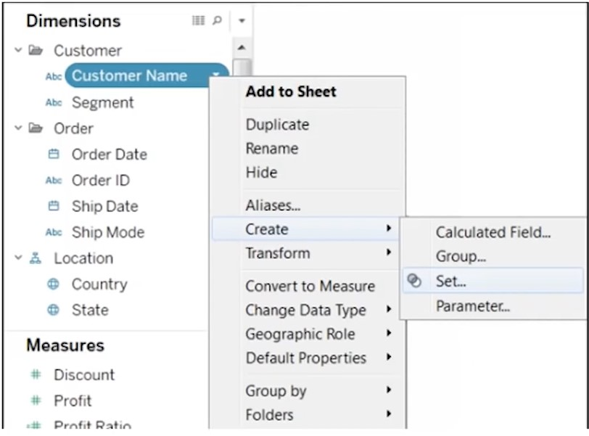
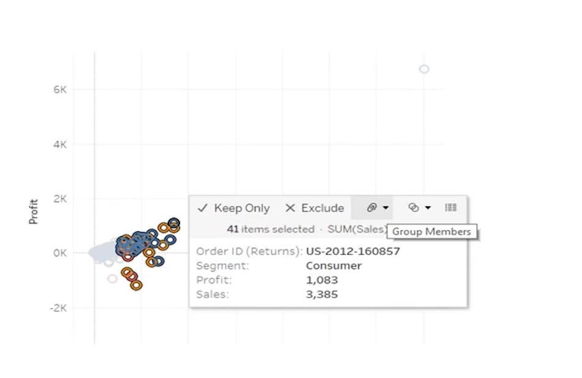
Groups
Groups are used to combine dimension members into higher level categories
You can group a dimension that contains states ,into regions
Groups are marked with a paper clip icon in the data pane

Slide 19
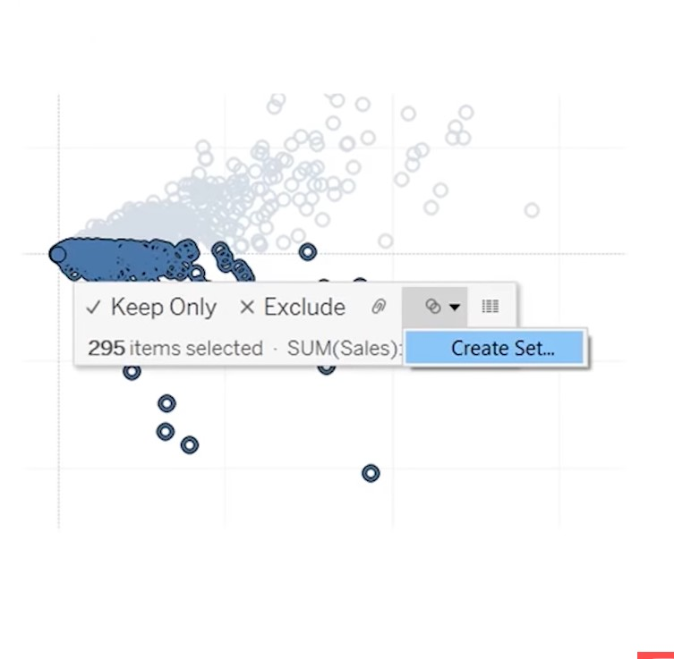
Sets
A subset of your data that meets certain conditions based on existing dimensions
Sets offer greater flexibility as you can link them to a condition
Sets appear in a separate window below your measure and subsequently are easier to locate .
You can group only within one dimension while with sets you can group across multiple dimensions.

Slide 20
Data Blending
Data blending is a method for combining data from multiple sources. Data blending brings in additional information from a secondary data source and displays it with data from the primary data source directly in the view. There are several ways to combine data, each with their own strengths and weaknesses.

Slide 21
Union
You can union your data to combine two or more tables by appending values (rows) from one table to another. To union your data in Tableau data source, the tables must come from the same connection

Slide 22
Tableau - Forecasting
Forecasting is about predicting the future value of a measure. There are many mathematical models for forecasting. Tableau uses the model known as exponential smoothing. In exponential smoothing, recent observations are given relatively more weight than older observations. These models capture the evolving trend or seasonality of the data and extrapolate them into the future. The result of a forecast can also become a field in the visualization created.
Tableau takes a time dimension and a measure field to create a forecast.

Slide 23
Tableau - Clustering
Clustering is a powerful feature in Tableau that allows you to easily group similar dimension members. This type of clustering helps you create statistically-based segments which provide insight into how different groups are similar as well as how they are performing compared to each other.

Slide 24
Calculated Fields
Calculated fields allow you to create new data from data that already exists in your data source. When you create a calculated field, you are essentially creating a new field (or column) in your data source, the values or members of which are determined by a calculation that you control.

Slide 25
Types of calculations
You create calculated fields using calculations. There are three main types of calculations you can use to create calculated fields in Tableau:
Basic calculations - Basic calculations allow you to transform values or members at the data source level of detail (a row-level calculation) or at the visualization level of detail (an aggregate calculation).
Level of Detail (LOD) expressions - Just like basic calculations, LOD calculations allow you to compute values at the data source level and the visualization level. However, LOD calculations give you even more control on the level of granularity you want to compute. They can be performed at a more granular level (INCLUDE), a less granular level (EXCLUDE), or an entirely independent level (FIXED) with respect to the granularity of the visualization.
Table calculations - Table calculations allow you to transform values at the level of detail of the visualization only.

Slide 26
Mapping Concepts in Tableau
If you want to analyze your data geographically, you can plot your data on a map in Tableau. This topic explains why and when you should put your data on a map visualization. It also describes some of the types of maps you can create in Tableau
With Tableau, you can create the following common map types:
Proportional symbol maps
Choropleth maps (filled maps)
Point distribution maps
Heatmaps (density maps)
Flow maps (path maps)
Spider maps (origin-destination maps)

Slide 27
Custom geocoding
Custom geocoding means that you assign latitude and longitude coordinates to your locations so Tableau can plot them accurately. It also allows you to create custom geographic roles that you can use as you create map views in Tableau.

Slide 28
Polygon maps in Tableau
Polygon maps in Tableau are created by looking up the coordinates of the shape you want to draw, and then connecting the dots by drawing a path between them. We encourage you to read the first two posts in this series mentioned in the opening paragraph if you are not familiar with these concepts.

Slide 29
Web Map Service (WMS)
In Tableau Desktop, you can connect to map servers with the Web Map Service (WMS) protocol. WMS is a standard protocol for requesting and receiving geographically referenced imagery.
You can connect to any WMS server that supports the WMS 1.0.0, 1.1.0, or 1.1.1 standards.

Slide 30
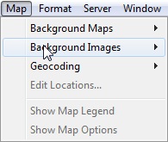
Background Images
Background images are images that you display underneath your data in order to add more context to the marks in the view. A common use of background images is adding custom map images that correspond to a coordinate system in your data.

Slide 31
THANKS….

